Slide 1
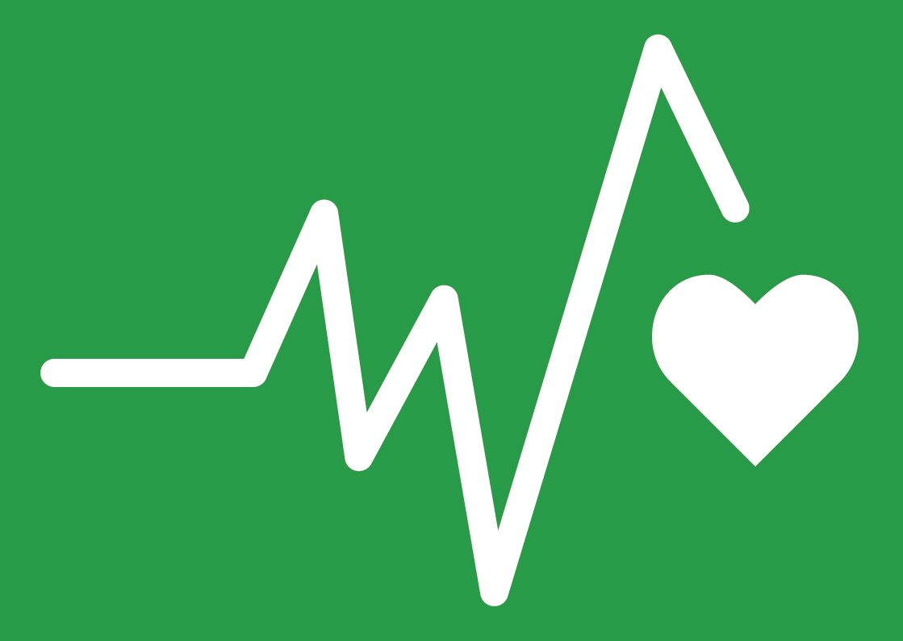
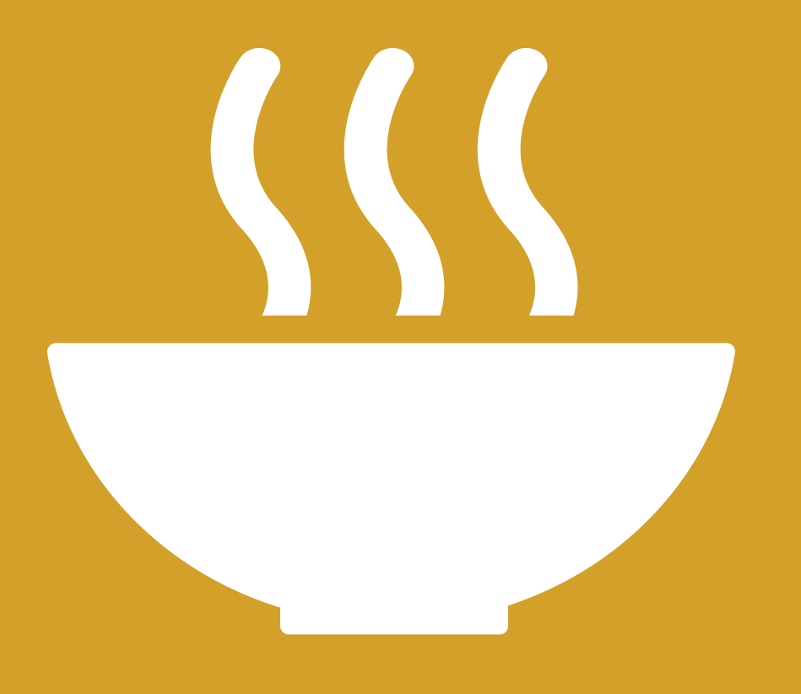

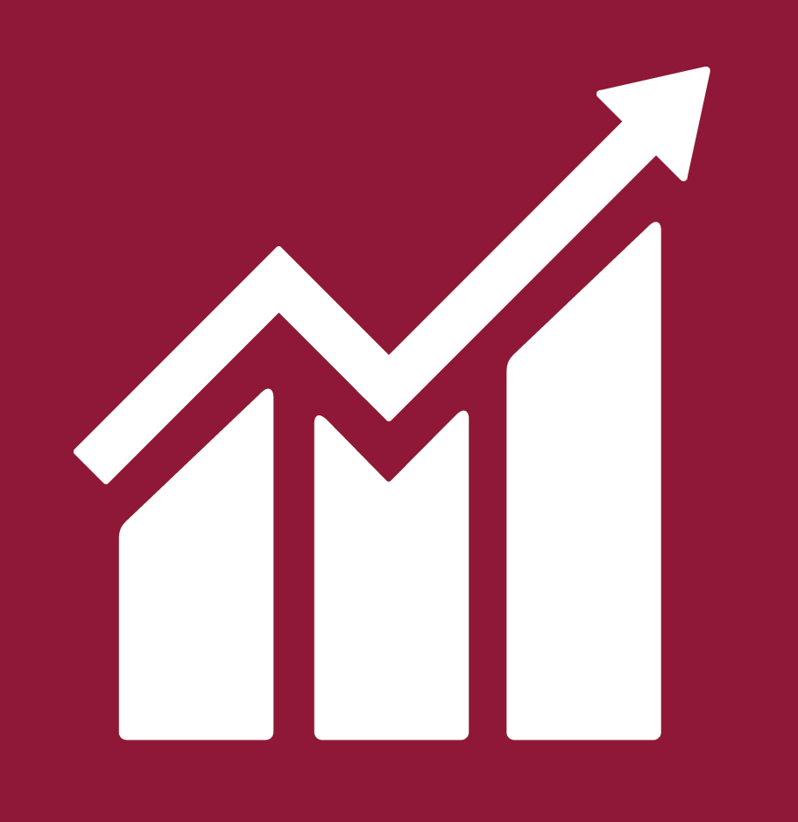

INNOVATIVE SOLUTIONS
FOR ADOLESCENTS
LIVING WITH HIV
Professor Lucie Cluver
Oxford University/University of Cape Town

Slide 2





























Slide 3
Notes:
The world of HIV is at a crossroads
We have moved from issue-focused MDGs to a set of joined up and holistic SDGs
But can this new development agenda provide solutions for ALHIV?

Slide 4
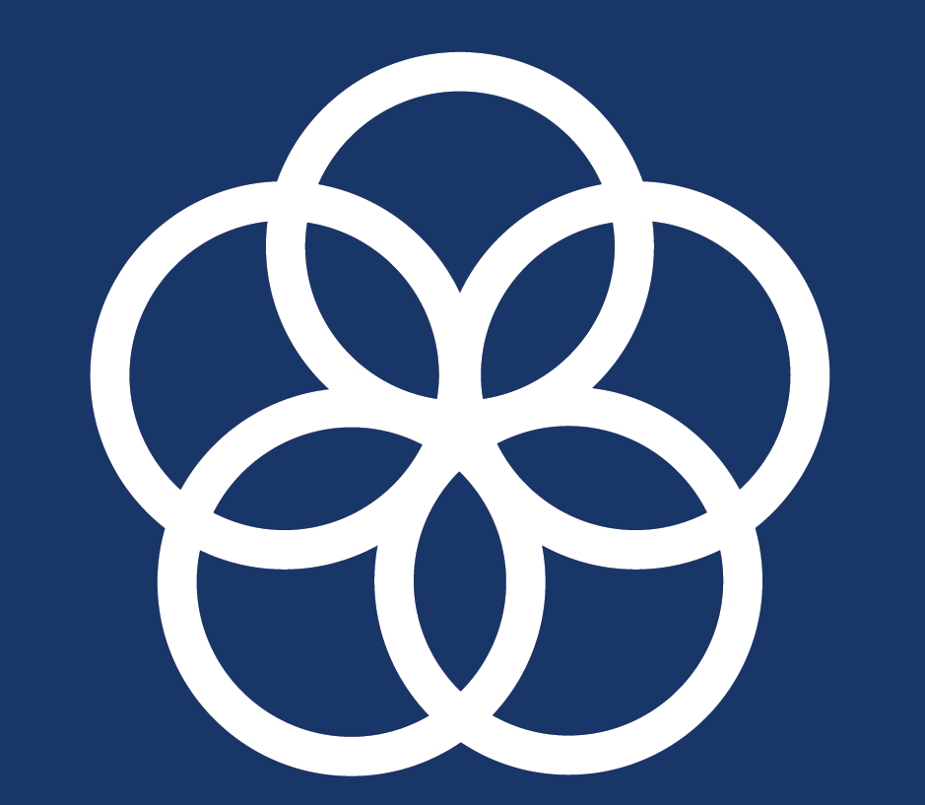
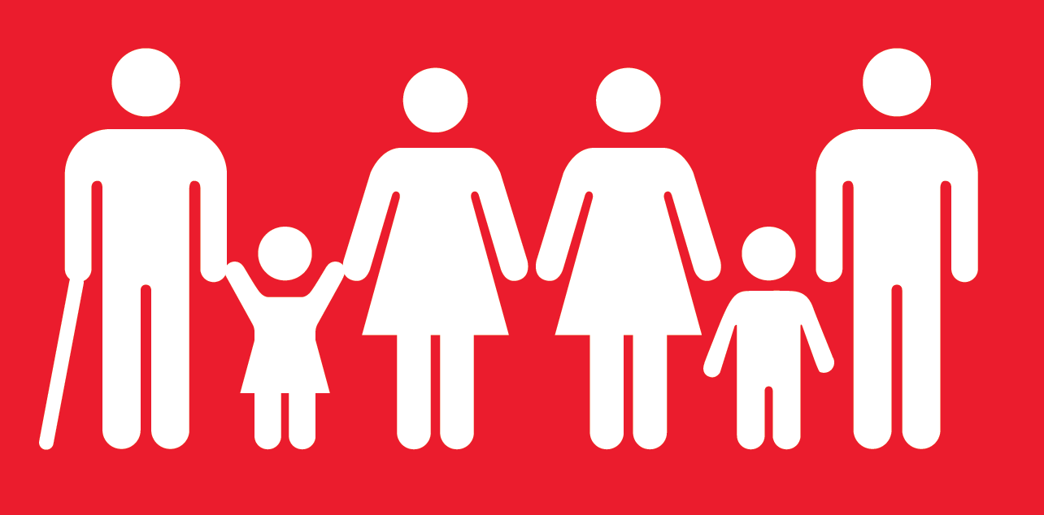
How can we make the SDGs work for ALHIV?
Do the SDGs predict clinical HIV outcomes?
Can SDG provisions improve HIV care?
How can we propel all adolescents
into Africa’s demographic dividend?

Slide 5

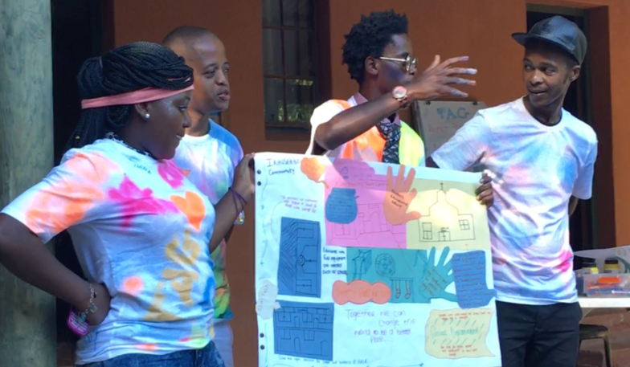
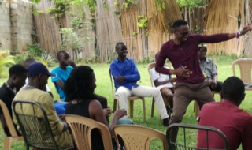
1000 living with HIV
1500 in severe poverty
1500 AIDS-affected
1000 violence-affected
NEW ADOLESCENT DATA
N=5500 2-year cohort
ADOLESCENT PARTICIPATORY GROUPS
South Africa, Uganda, Sierra Leone
Notes:
Exciting new data will allow us to test this question with large-scale evidence in Africa
5500 adolescents in a longitudinal quasi-experimental design in three rural and urban South African provinces
3 adolescent advisory groups: SA, Uganda, Sierra Leone, over 10 years.
We will focus on new findings from the 1000 adolescents living with HIV

Slide 6
Violence and viral load (n=1060)
Violence type, %, impact on non-adherence
Physical abuse 20% OR 1.4
Teacher violence 41% OR 1.7
IPV 12% OR 1.7
Clinic shouting 19% OR 2.1
Marginal effects controlling for age, gender, location, informal housing, maternal death, paternal death, vertical or horizontal HIV infection, general health, date of ART initiation, type of healthcare facility, pediatric, general care
Cluver, L. Meinck, F. Toska, E… Sherr, L. (2018). AIDS.
Notes:
We often focus on health outcomes for ALHIV – and this is absolutely understandable.
2-year adherence rates of 29%, viral load failure 42%
BUT the evidence shows that the predictors of these health outcomes are not only in clinical care but span the SDGs: violence, poverty

Slide 7
Adolescent girls: HIV and motherhood impact across SDGs
Notes:
We also see that for adolescents, living with HIV interacts with other vulnerabilities to increase risks across multiple SDGs
Here, new data from 2018 shows that being HIV+ and an adolescent mother results in a fourfold increase in school dropout – from 10% to 45%
And a 6-fold increase in age-disparate sex – from 4% to 27%

Slide 8
More SDG-aligned provisions: more survival (n=1060)
SDG 1+2 Basic needs & social protection | .625*
SDG 3 Healthy caregiver | .574***
SDG 8 Household Access to work | .672**
SDG 16 Protection from child abuse | .652**
Cluver, Pantelic, Toska, Orkin, Medley, Sherr (2018) JIAS.
Notes:
We see that access to provisions across the SDGs can directly increase the chances of survival for adolescents living with HIV.
This graph shows rates of viral failure or pulmonary tuberculosis, by access to SGD-aligned provisions such as social protection, employment and violence orevention
We see that survival risks for adolescents living with HIV go down from 51% with none of the SDG provisions, to 13% with four.

Slide 9
Cash + care + clinic: retention in HIV care (n=1060)
Stocked with medication OR 3.0*** CI 1.6-5.5
Time for teens by staff OR 2.7*** CI1.8-4.2
Accompanied by family to clinic OR 2.4*** CI1.6-3.7
Cash for transport to clinic OR 1.4* CI1.1-2.0
Kind Staff at Clinic OR 2.5*** CI1.8-3.6
Cluver, Pantelic, Toska, Orkin, Casale, Bungane, Sherr, JIAS in press
Notes:
We also see that even when we look at clinical predictors of clinical outcomes
That adding components from other SDGs leads to greater impact.
So here we see key clinical predictors of retention in care – sufficient stocks of ART, healthcare staff time and kindness
But when we add in poverty-related predictors of enough money for transport to clinics (SDG1) and family accompaniment to clinic (SDG 16)
We see that the combination has a far greater impact
With none of these factors adolescents living with HIV have a 3% chance of retention in care,
With all 5 STACK factors, they have a 70% chance.

Slide 10
Notes:
So the causes of risk for ALHIV cross the SDGs… and the consequences of HIV cross the SDGS.
But can the solutions also cross the SDGs?
And here is where an exciting new concept comes in.
UNDP’s Development Accelerators are policies or programmes with simultaneous impacts across multiple SDG goals or targets
But this hadn’t yet been tested in real data with real adolescents

Slide 11

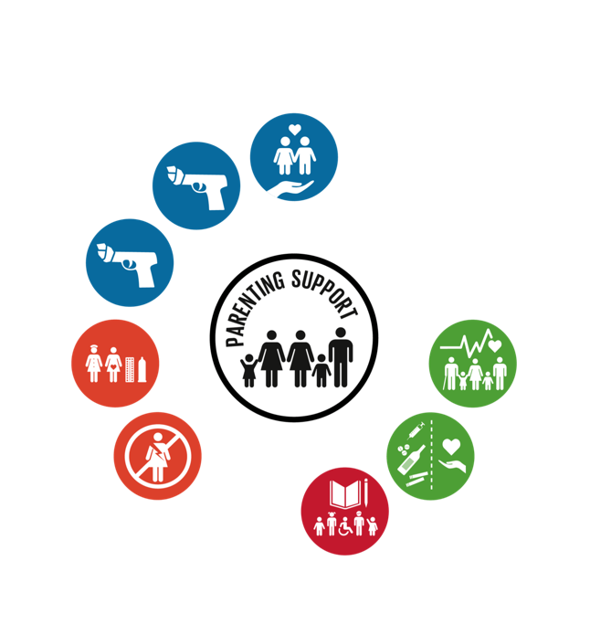
Accelerator effects
% improvement on incidence rates of targets in SDG3 (Health) SDG 4 (Education) SDG 5 (Gender equality) and SDG 16 (Peace)
15%
14%
12%
20%
14%
30%
24%
15%
20%
16%
21%
14%
16%
14%
28%
14%
18%
14%
N=1000 adolescents living with HIV, South Africa. Marginal effects of logistic regressions for incidence rates of SDG outcomes, controlling for baseline outcome, other predictors, age, gender, urban/rural residence.
Notes:
Until now.
These are analyses finished last week, looking at just two accelerator interventions
They are prospective longitudinal marginal effects, testing impacts on incidence rates of key targets across SDGs 3, 4, 5 and 16.
We see that access to a safe school (where adolescents are not victims of physical violence) has positive impacts across 10 SDG targets, including retention in HIV care and ART adherence.
We also see that parenting support has positive impacts across 8 SDG targets, including reduction in sexual abuse and higher school enrolment.

Slide 12
Super-accelerator effects
no abuse + 21%
HIV care retention
+ 14%
no violence perpetration
+ 26%
no community violence
+ 31%
ART adherence
+ 31%
good mental health
+ 31%
no high-risk sex
+ 30%
no substance use
+ 31%
no sexual abuse
+ 14%
school enrolment
+ 15%
school progression
+ 19%
Notes:
Next questions – what doesn’t work individaully but does in combination – ie cash and business skills
Use imagery of chemical experiment where it blows up!

Slide 13
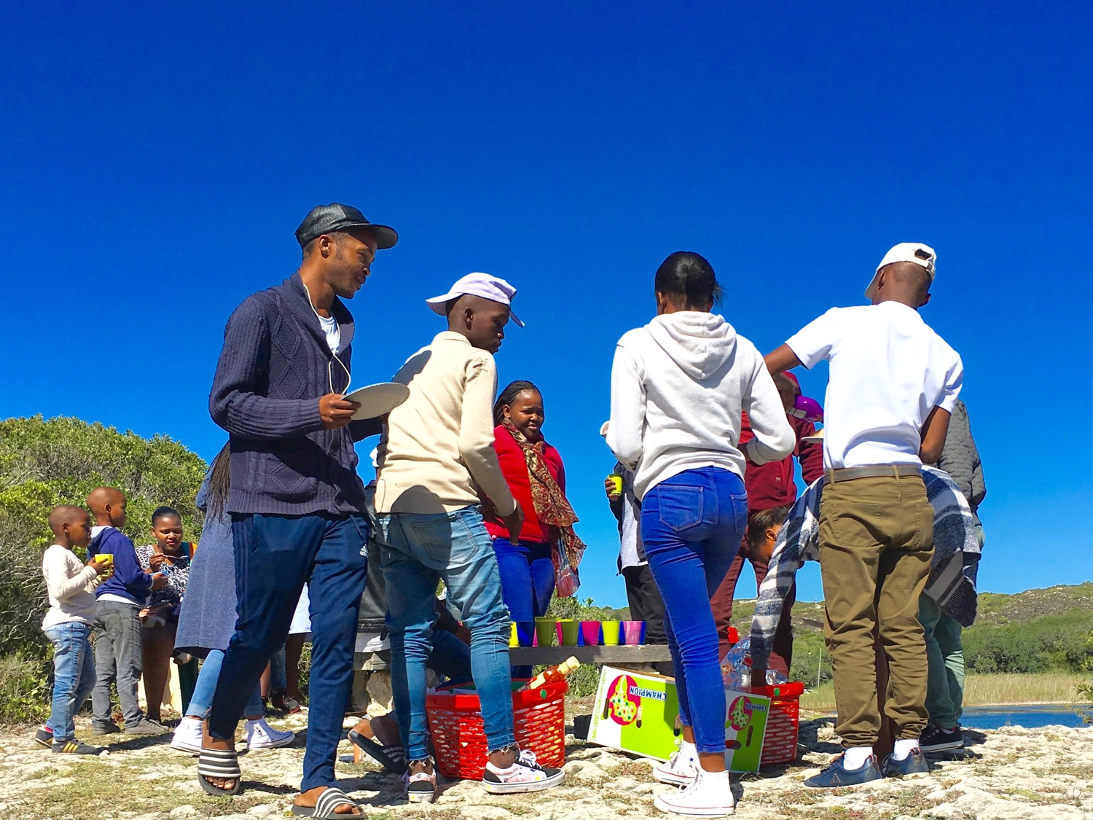
Notes:
The SDGs are here to stay.
And we – as an HIV world – have a choice to make.
We can retreat into SDG3 of Health, and try to protect our shrinking budgets
Or we can capitalise on new evidence to find new solutions for ALHIV
That improve not only their health, but their education, their safety and their employment opportunities.
And may also improve the lives of Africa’s 435 million adolescents by 2050.
We can be left behind, or we can be leaders in this new development world.

